Slide 1
Restaurant Revenue Prediction
Huiyang Hu, Zepeng Cui, Haoran Wang, Ziying Xiang, Jingwei Yao

Slide 2
Objective
We hope to find a fit model that could help predict the revenue of other restaurants

Slide 3
Data Description
* Id : Restaurant id.
* Open Date : opening date for a restaurant
* City : City that the restaurant is in. Note that there are unicode in the names.
* City Group: Type of the city. Big cities, or Other.
* Type: Type of the restaurant. FC: Food Court, IL: Inline, DT: Drive Thru, MB: Mobile
* P1, P2 - P37: There are three categories of these obfuscated data. Demographic data are gathered from third party providers with GIS systems. These include population in any given area, age and gender distribution, development scales. Real estate data mainly relate to the m2 of the location, front facade of the location, car park availability. Commercial data mainly include the existence of points of interest including schools, banks, other QSR operators.
* Revenue: The revenue column indicates a (transformed) revenue of the restaurant in a given year and is the target of predictive analysis. Please note that the values are transformed so they don't mean real dollar values.

Slide 4
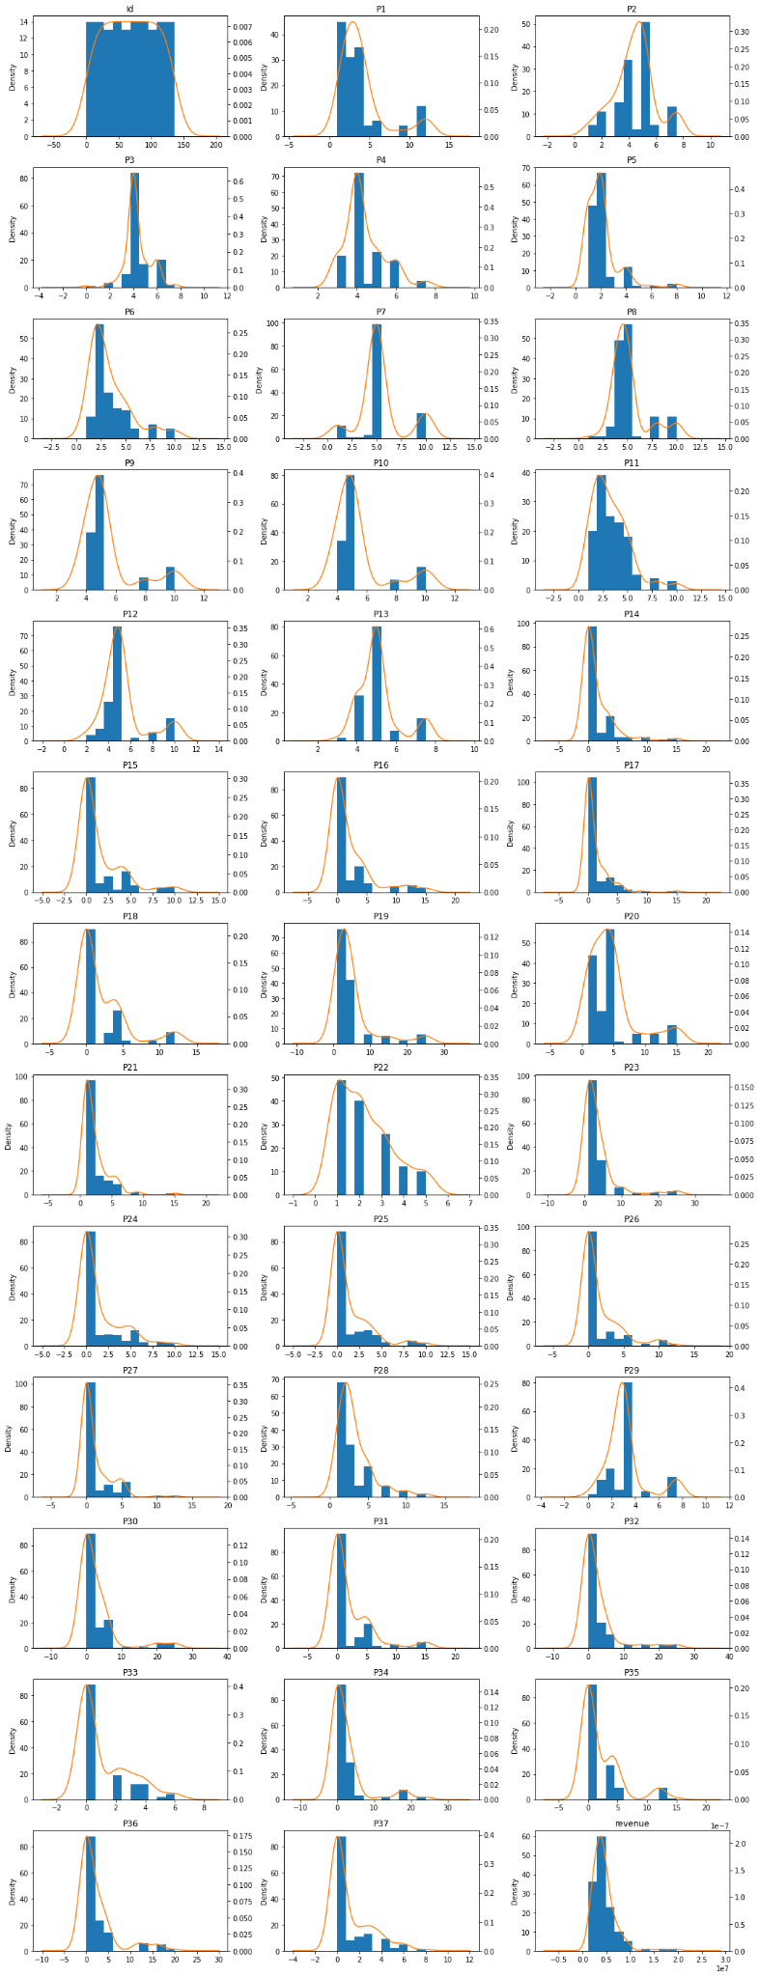
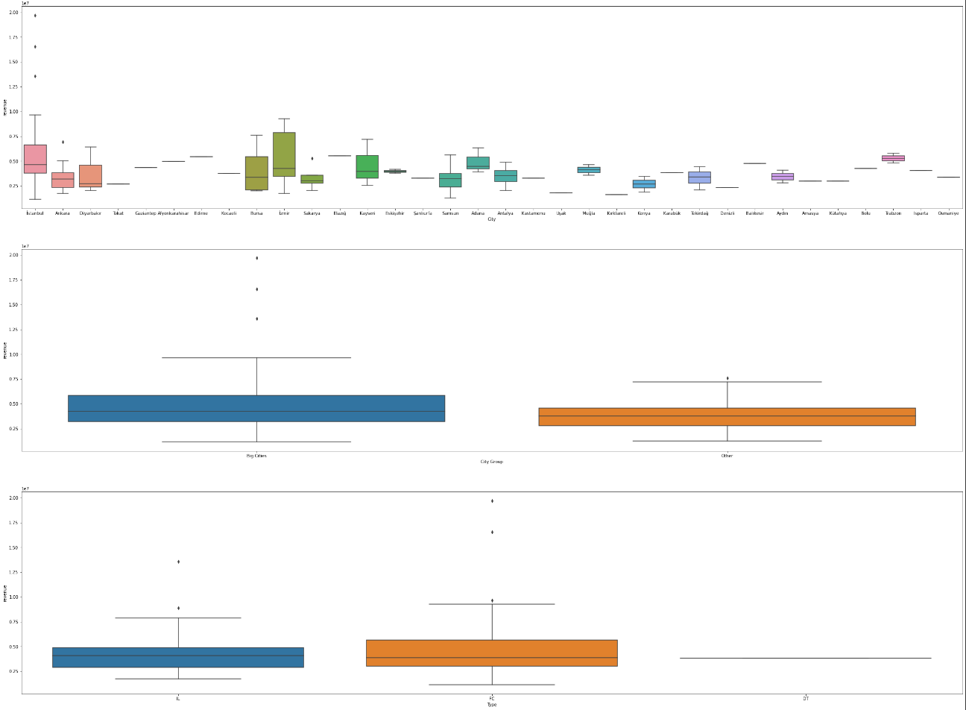
Distribution of numerical and categorical variables
All the variables belong to the skewed distribution and even in some variables like P14-18, 24-27 and 30-37, the zero accounts for the biggest part, which probably indicates kind of missing values or other entry problems.
Revenue varies a lot in different categories.

Slide 5
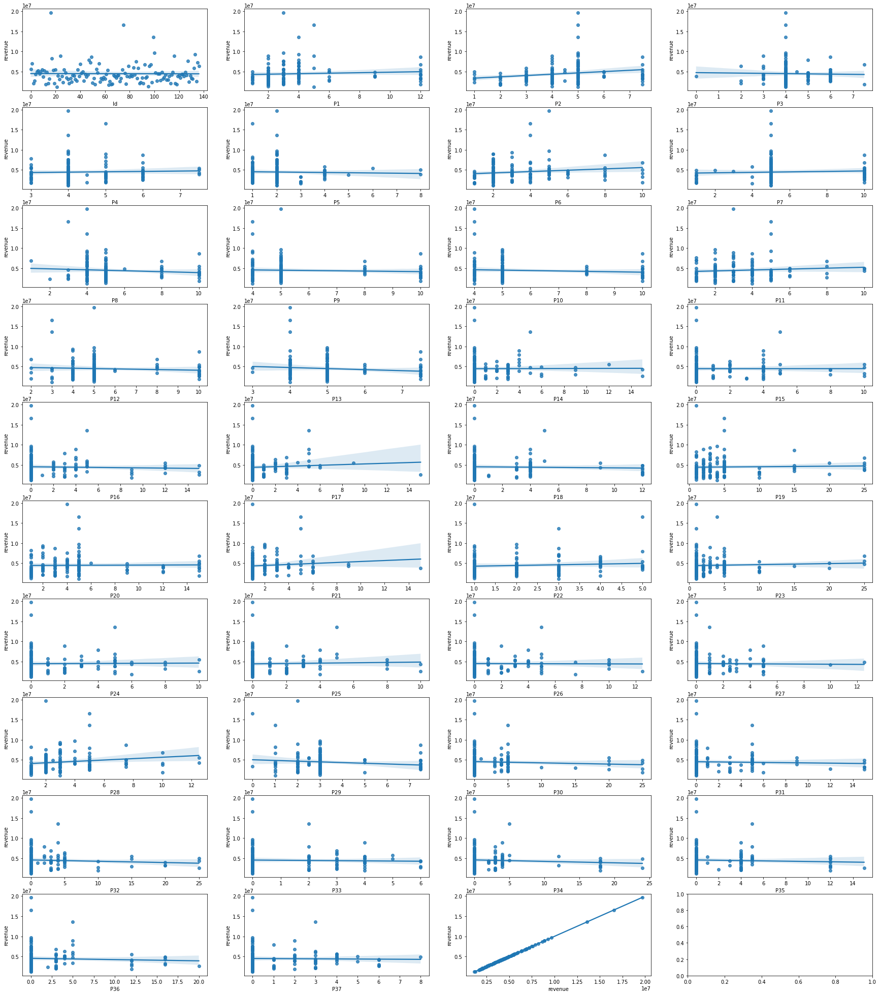
Relationship between numerical variables and revenue
There is no obvious linear relationship between these numberical variables and revenue.

Slide 6
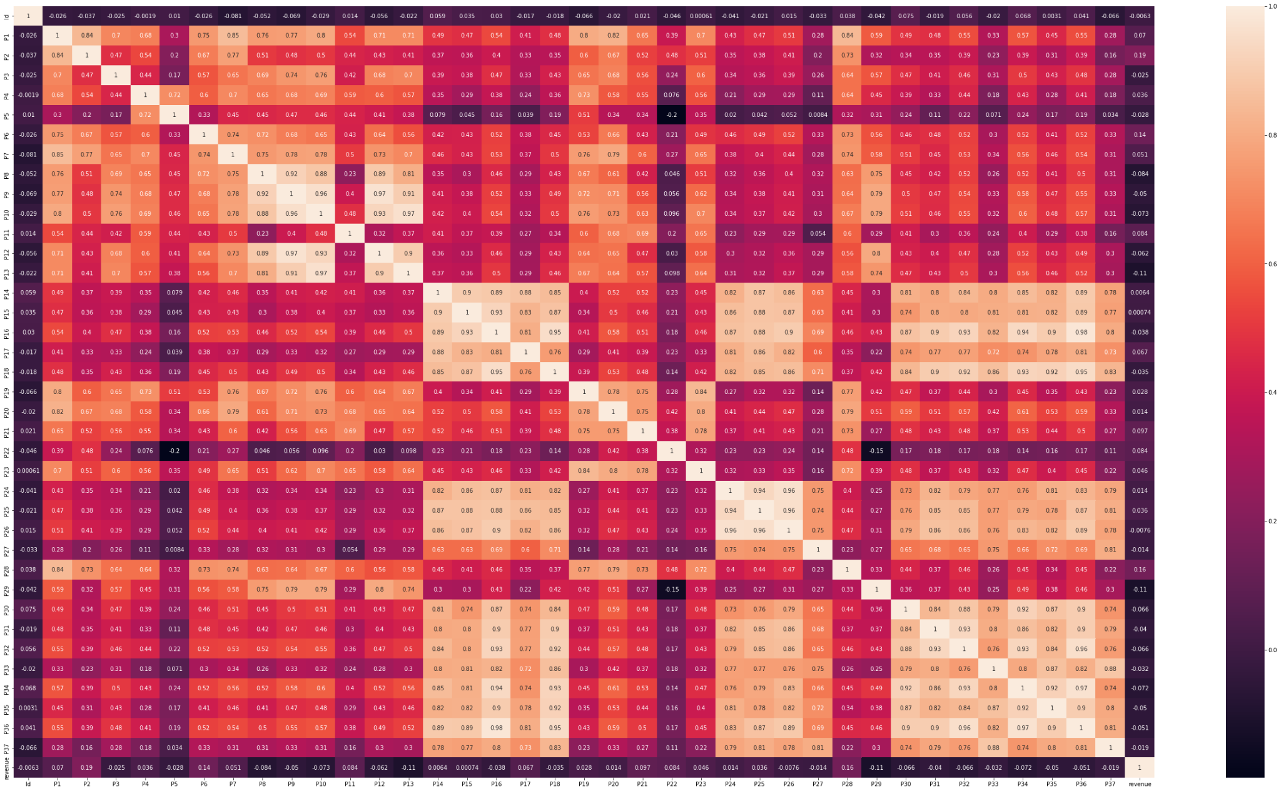
Correlation within numerical variables
There is no significant correlation within numerical variables.

Slide 7
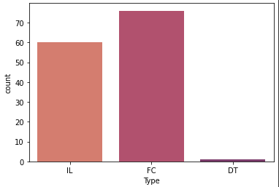
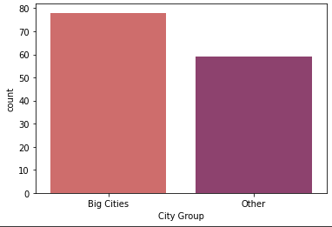
Create Dummy Variables
Big cities exactly include Ankara, Istanbul and Izmir so we amy remove City, and create a new dummy variable “Big cities”.
As for restaurant type we can see that Food Court(FC) has the most count, we will create a dummy variable for Food Court.

Slide 8
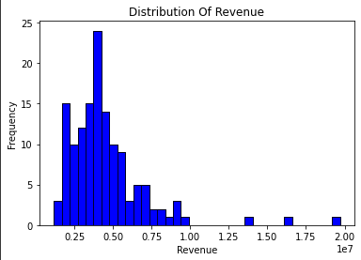
Distribution of Revenue
Revenue is right skewed and we can visually spot three outliers in this graph.
Normally distributed data with no outliers tend to give a better performance for linear regression related algorithms such as Ridge&Lasso.

Slide 9
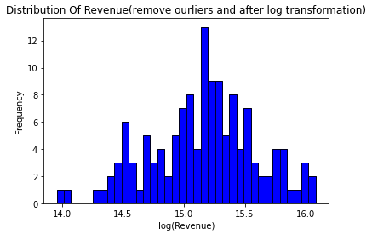
Log Transformation & Remove outliers
After log transformation the distribution for revenue became normally distributed.
However we found out two new outliers around log(Revenue) 14.

Slide 10
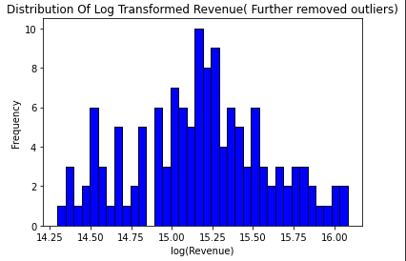
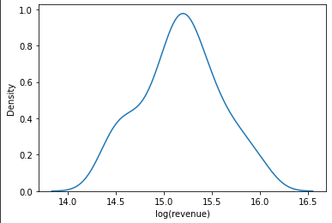
Remove new outliers
After we remove the outliers again, we found that the data not is normally distributed, and there are no outliers anymore.

Slide 11
Standardization & data split
Use StandardScaler to standardize features
Split the data into 20% of test datasets and 80% of train datasets due to the limitation of data.
Set up seed for random state to 42.

Slide 12
Ridge & Lasso Regression
Very close relationship with linear regression
Preventing overfitting issues as linear regression might have
Lasso regression use L1 norm, which will take the absolute value of the sum of all values
Ridge regression use L2 norm, which will take the square-root of the sum of all values

Slide 13
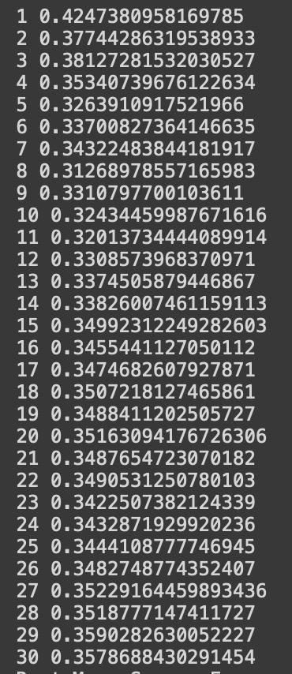
KNN regressor
Supervised Machine Learning Model
Use the average of the revenue of the nearest restaurants to predict the revenue of the target restaurant
We changed the parameter n_nerighbors from 1 to 30 and found the best number is 8, making RMSE 0.3310797700103611.

Slide 14
Support Vector Regression(SVR)
Supervised machine learning model
SVR tend to perform better with high dimensional datasets
Predicting well with small sample size

Slide 15
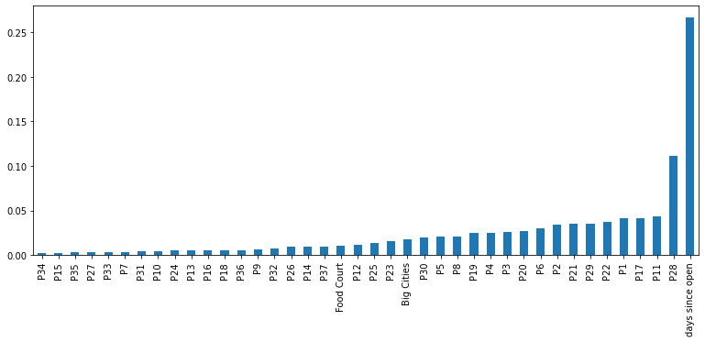
Random Forests Regressor
Supervised machine learning model
Different subsets are randomly sampled from the data provided for the establishment of multiple different decision trees, and the results of a single decision tree are integrated according to Bagging rules.
The regression prediction results of the whole forest are obtained by integrating the results of all trees and taking the average value.
 | Base line model | Hyper-parameter tuning
RMSE | 0.3451117456497894 | 0.38573998411567584

Slide 16
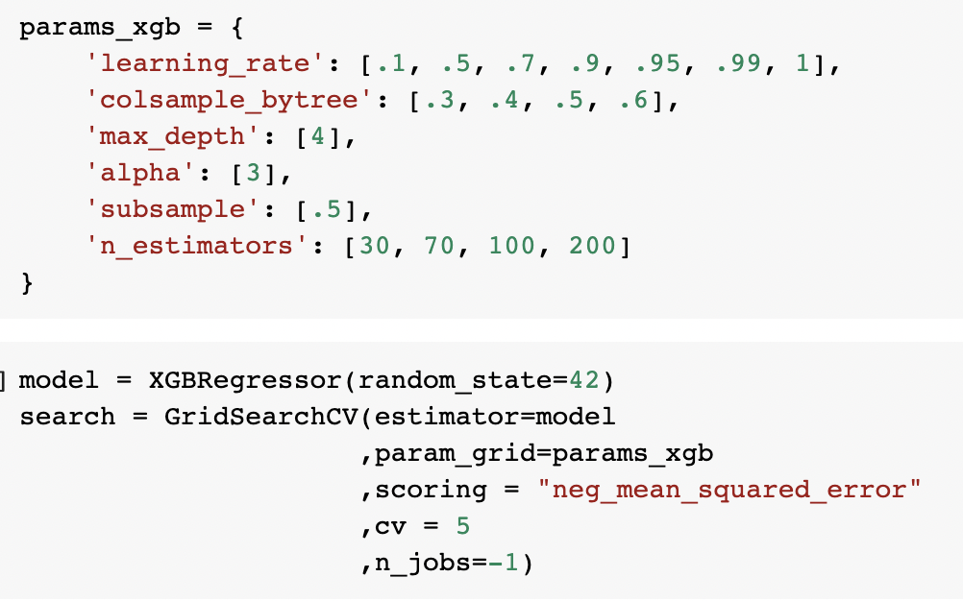
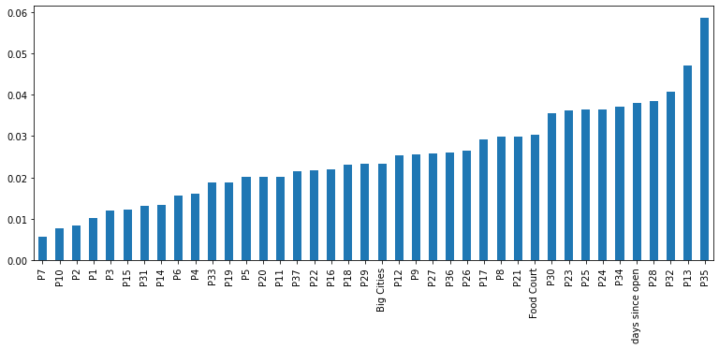
XGBoost
Used for supervised learning problems
XGBoost is a tree integration model, which calculates each unique feature value and can find a specific feature value as a segmentation point
The idea of the XGBoost algorithm is to keep adding trees, keep splitting features to grow a tree, and each time you add a tree, you're actually learning a new function to fit the residuals that you predicted last time.
 | Base line model | Hyper-parameter tuning
RMSE | 0.3776185835762194 | 0.3660785509060014

Slide 17
Gradient Boosting
Best Model:
model = GradientBoostingRegressor(n_estimators = 124, random_state=0, min_samples_split=2,min_samples_leaf=23,subsample=1,min_weight_fraction_leaf=0,max_depth=3,
min_impurity_decrease=0,learning_rate=0.1)
After extensive hyperparameter tuning, we come to the best gradient boosting model with a rmse of 0.33003408231245746

Slide 18
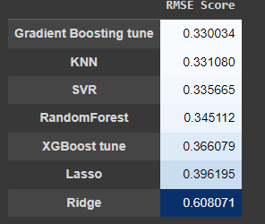
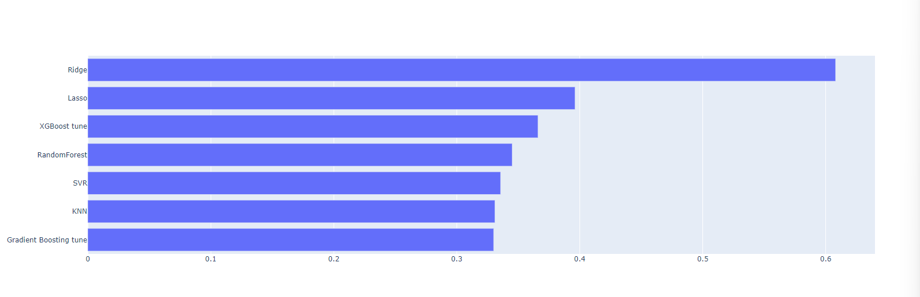
Model Comparison
Except Ridge Regression, all models have RMSE less than .4, and the difference among them is very small. Gradient Boosting has the best RMSE score .33. Gradient Boosting, KNN, and SVR have RMSE less than .34, which are three best models for our dataset.
By using the untransformed data, to get a more specific number in the unit of dollars we had a Root Mean Square Error of $1592029.49. Even though it is a quite large number, this is the best result we have.

Slide 19
Conclusion
By using our best model to predict the non-log dependent variable we had a Root Mean Square Error of $1592029.49.
Boosting related algorithms tend to out performs linear regression related algorithms
Strong linear relationships might not be found in this datasets
Gradient Boosts have more advantages learn complex non-linear decision boundaries via Boosting.
SVR & KNN also have the feature of working better on non-linear relationships, which could be potentially have a higher score.

Slide 20
Limitation
Very Narrowed Datasets
Unkown variables
Unbalance on City variable, large bias in prediction for the restaurants in these small cities

